Slide 1
Environmental Improvement Program Energy Production & Consumption

Slide 2
Environmental Improvement Program Energy Targets
1.) 5-15% reduction in electricity carbon dioxide equivalent (CO2-e) emissions per EFTSL + FTE by December 2020 (2008 TEFMA baseline).
2.) Increase production of clean energy from 5% (2008 baseline) to 15% by 2020.
3.) Remain in the top quartile of TEFMA benchmarking each year for energy consumption /EFTSL

Slide 3
Energy Consumption
Note* this is only from the electricity and gas we consume
Bunbury/ Joondalup and MT Lawley campus
OR 1.45 Tonnes Co2-e /EFTSL + FTE

Slide 4
The total carbon footprint was calculated as 35,857 tonnes of CO2-e for 2008. Fleet vehicles are offset and 5% of electricity is sourced from renewable energy supplies.
ECU’s Carbon Footprint (2008)
We do not have to report under the National Energy and Greenhouse Reporting System

Slide 5
 |  |  | Joondalup 2009
Month | Total Usage KwH | CO2 Emission KG | CO2 Emission Tonnes | EFTSL | CO2 Emission/EFTSL | Total costs | Costs p EFTSL
1st Quarter | 3,050,175.00 | 3,190,483.05 | 3,190.48 | 7,781 | 0.41 | $283,928.09 | $36.49
2nd Quarter | 3,629,154.00 | 3,796,095.08 | 3,796.10 | 7,781 | 0.49 | $247,414.45 | $31.80
3rd Quarter | 3,844,696.55 | 4,021,552.59 | 4,021.55 | 7,781 | 0.52 | $373,137.65 | $47.95
4th Quarter | 3,278,883.13 | 3,429,711.75 | 3,429.71 | 7,781 | 0.44 | $357,432.49 | $45.94
Total | 13,802,908.68 | 14,437,842.48 | 14,437.84 | 7,781 | 1.86 | $1,261,912.68 | $162.18
 |  |  | Mt Lawley 2009
Month | Total Usage KwH | CO2 Emission KG | CO2 Emission Tonnes | EFTSL | CO2 Emission/EFTSL | Total costs | Costs p EFTSL
1st Quarter | 2,234,521.40 | 2,337,309.38 | 2,337.31 | 6,559 | 0.36 | $219,847.11 | $33.52
2nd Quarter | 2,934,509.00 | 3,069,496.41 | 3,069.50 | 6,559 | 0.47 | $221,143.17 | $33.72
3rd Quarter | 2,833,830.87 | 2,964,187.09 | 2,964.19 | 6,559 | 0.45 | $296,316.59 | $45.18
4th Quarter | 2,346,410.75 | 2,454,345.65 | 2,454.35 | 6,559 | 0.37 | $318,214.04 | $48.52
Total | 10,349,272.02 | 10,825,338.53 | 10,825.34 | 6,559 | 1.65 | $1,055,520.91 | $160.93
 |  |  | Bunbury 2009
Month | Total Usage KwH | CO2 Emission KG | CO2 Emission Tonnes | EFTSL | CO2 Emission/EFTSL | Total costs | Costs p EFTSL
1st Quarter | 247,118.00 | 258,485.43 | 258.49 | 767 | 0.34 | $45,636.57 | $59.526
2nd Quarter | 376,034.00 | 393,331.56 | 393.33 | 767 | 0.51 | $59,670.54 | $77.832
3rd Quarter | 325,969.00 | 340,963.57 | 340.96 | 767 | 0.44 | $78,466.98 | $102.349
4th Quarter | 243,614.00 | 254,820.24 | 254.82 | 767 | 0.33 | $59,985.97 | $78.243
Total | 1,192,735.00 | 1,247,600.81 | 1,247.60 | 767 | 1.63 | $243,760.06 | $317.951
 |  |  | TOTAL ECU 2009
Month | Total Usage KwH | CO2 Emission KG | CO2 Emission Tonnes | EFTSL | CO2 Emission/EFTSL | Total costs | Costs p EFTSL
1st Quarter | 5,531,814.40 | 5,786,277.86 | 5,786.28 | 15,107 | 0.38 | $549,411.77 | $36.37
2nd Quarter | 6,939,697.00 | 7,258,923.06 | 7,258.92 | 15,107 | 0.48 | $528,228.16 | $34.97
3rd Quarter | 7,004,496.42 | 7,326,703.25 | 7,326.70 | 15,107 | 0.48 | $747,921.22 | $49.51
4th Quarter | 5,868,907.88 | 6,138,877.64 | 6,138.88 | 15,107 | 0.41 | $735,632.50 | $48.70
Grand Total | 25,344,915.70 | 26,510,781.82 | 26,510.78 | 15,107 | 1.75 | $2,561,193.65 | $169.54

Slide 6
Environmental Improvement Program Energy Management Group
Lighting
Air-conditioning
IT
New buildings
Research and investigation
Monitoring
Environmental education
Two large ongoing projects:
1.) Finding funding to install energy meters on each building so we can calculate electricity consumption on a building by building basis.
2.) To investigate what type of energy production system is most effective for ECU.
The energy program is funded with 25k per year from F & S funding.

Slide 7
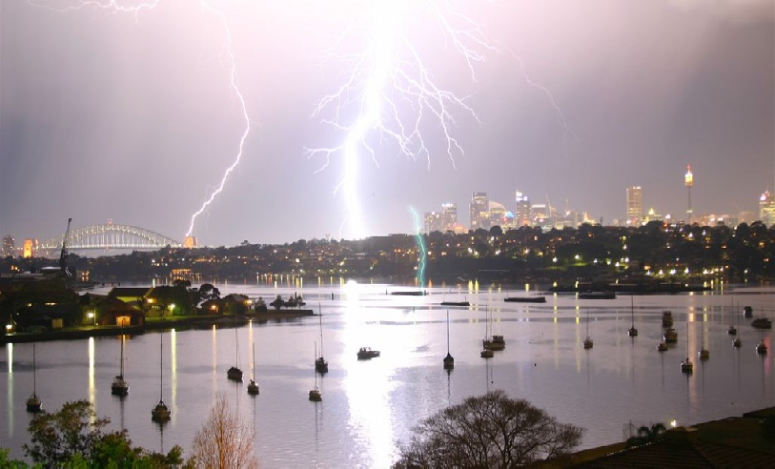
Environmental Improvement Program Energy Management Group

