Slide 1

12 ATAR Biology Revision Seminar Unit 4
Rachel Donnelly 2024

Slide 2
Never measure the height of a mountain until you reach the top.
Then you will see how low it was.
Dag Hammerskjold

Slide 3
Unit 4: Surviving in a Changing Environment
Learning Outcomes
By the end of this unit students will
understand the mechanisms by which plants and animals use homeostasis to control their internal environment in a changing external environment
understand the ways in which infection, transmission and spread of disease occur in vector-borne diseases
understand how biological models and theories have developed over time
use science inquiry skills to design, conduct, evaluate and communicate investigations into organisms’ responses to changing environmental conditions and infectious disease
communicate biological understanding using qualitative and quantitative representations in appropriate modes and genres.

Slide 4
Understand the mechanisms by which plants and animals use homeostasis to control their internal environment in a changing external environment.
PART ONE:
Homeostasis
  stimulus-response model
  negative feed-back loops
Tolerance limits
Thermoregulation
Water and Salt balance
Nitrogenous waste
Xerophytes and halophytes

Slide 5
Homeostasis
The process by which the body (organism) maintains a relatively constant internal environment.

Slide 6
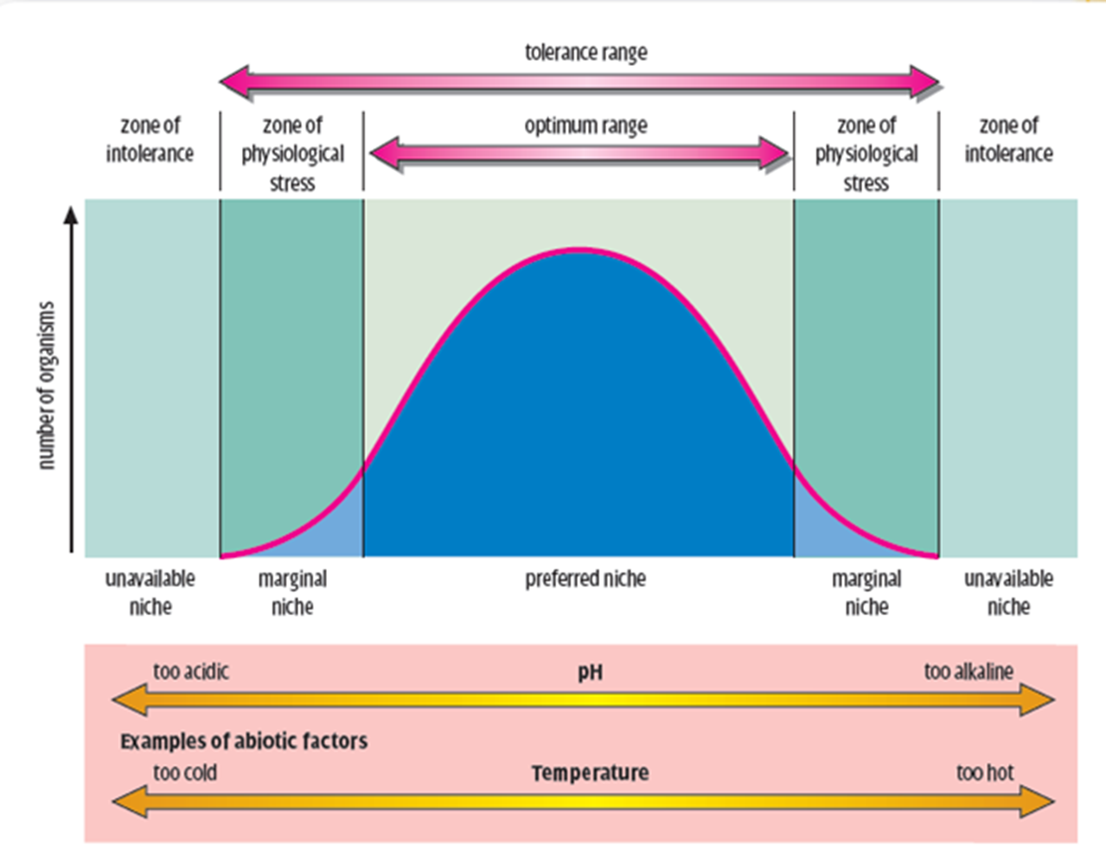

Slide 7
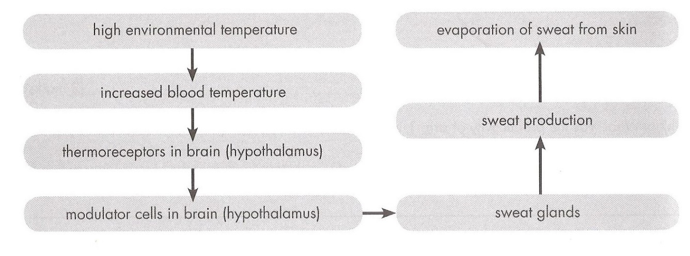
Homeostasis Q1
NEGATIVE FEEDBACK
Blood temperature decreases
STIMULUS
RECEPTOR
Internal RESPONSE
MODULATOR
EFFECTOR

Slide 8
Positive feedback v’s Negative feedback
Positive feedback | Negative feedback
Reinforces (amplifies) the change detected It will continue until a result is achieved. | Reduces the change- it is the reverse of the stimulus. Promotes equilibrium.
Example 1: Labour (child birth): oxytoxin hormone is released when the babies head pushes against the cervix. Oxytoxin causes contraction of the uterus- pushing the babies head against the cervix. This continues until the baby is born. Example 2: Blood clotting Example 3: Fruit ripening | Example 1: temperature regulation- sweating to reduce a rise in body temperature. Example 2: osmoregulation Example 3: blood sugar regulation

Slide 9
Question 2: Many Australian mammals do not sweat. In order to cool themselves they will pant. Describe, in detail, the homeostatic mechanism of panting.
STIMULUS: increase in core body temperature.
RECEPTOR: thermoreceptors. [electrical/nerve message sent to modulator]
MODULATOR: hypothalamus [electrical/nerve messages sent].
EFFECTORS:
  Respiratory muscles (diaphragm, intercostal muscles)- increase breathing rate.
  Blood vessels/arterioles in tongue & mouth- vasodilation.
  Salivary glands- increase saliva production.

Slide 10
Question 2 continued…
RESPONSE:
  Panting- short rapid breathing- heat loss through evaporation.
  Vasodilation (of arterioles NOT capillaries), heat loss through conduction/convection.
  Saliva production- heat loss through evaporation (uses energy).
FEEDBACK: decrease in core body temperature. [negative feedback because it opposite of the stimulus.]
Notes:
Vasodilation increases blood flow, evaporation uses heat energy (phase change from liquid to gas atoms gain energy

Slide 11
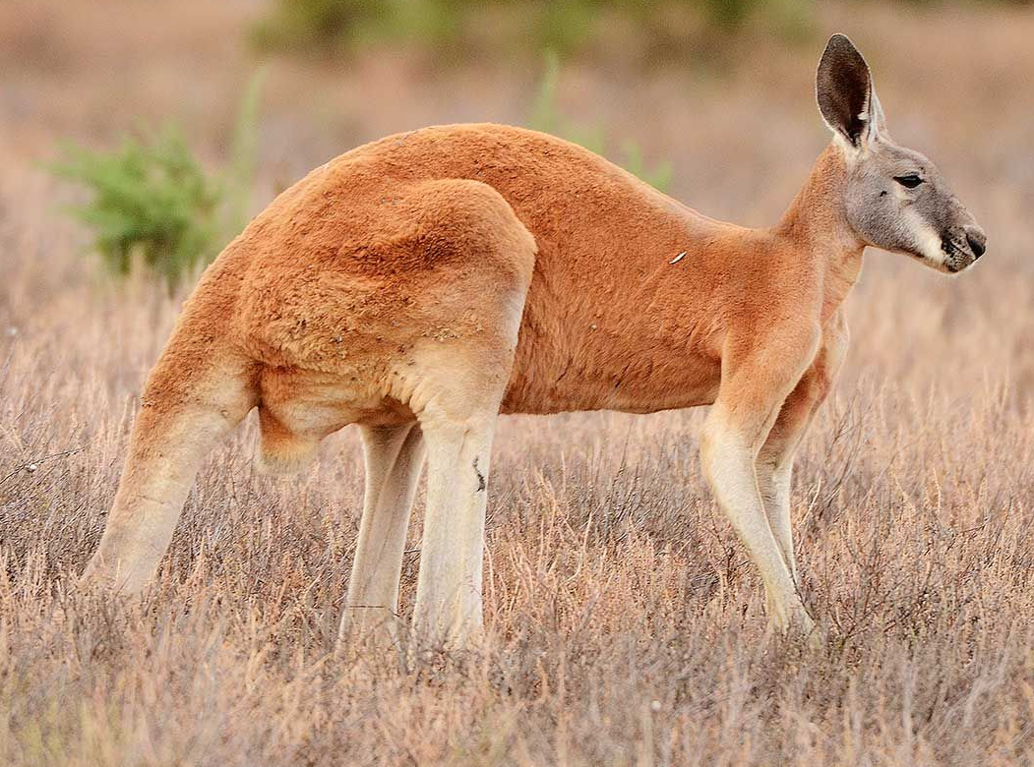
Most active at dawn and dusk when it is cooler
Sweating: during periods of activity
Rests in the shade during the heat of the day
Panting: reduces body temperature
Crouch with tail under body to reduce amount of surface exposed to sun
Licks forearms: evaporation of moisture reduces body temp.
Shiver during cold weather
Can redirect blood flow away from extremities to reduce heat loss
Michael Seebeck photography

Slide 12
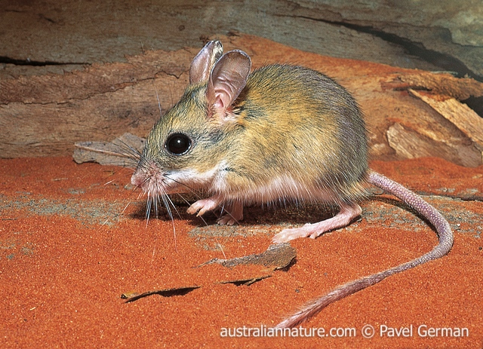
Large ears to increase SA for heat loss
Burrows: provides cool environment.
In heat individuals lay flat to increase SA:Vol ratio = ↑ heat loss
Huddling behaviour increases warmth- reduces SA:Vol ratio = ↓ heat loss
Nocturnal

Slide 13
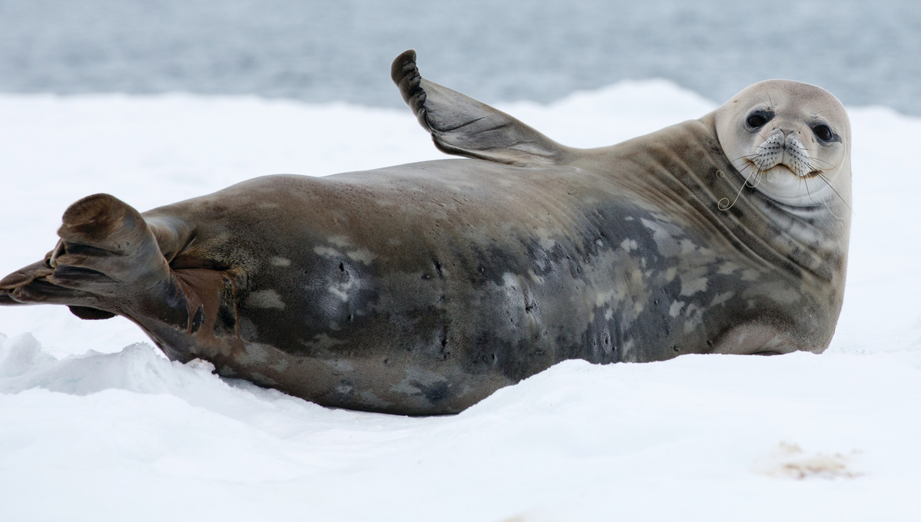
Counter-current blood flow
Blubber- insulation
How you doing?

Slide 14
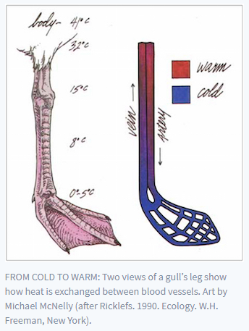

1. Warm arterial blood from the body moves towards extremities
4. Venous blood has been warmed by the time it returns to the body.
2. Heat passes from the arteries to the vein warming the cold blood returning from the foot. Blood vessels in close proximity.
3. The arterial blood is cooler so it loses less heat at the extremities.
The temperature gradient between the foot & the environment is much less, therefore less heat is lost.

Slide 15
Often WACE questions will ask you to apply biology concepts to a context. An example below:
Q4.Marine iguanas (Amblyrhynchus cristatus) are endemic to the Galapagos Islands, situated in the Pacific Ocean off the coast of Ecuador. The marine Iguana is classified as a marine reptile as it is the only species of iguana to forage within the ocean. Even though the islands are located close to the equator, the waters are extremely cold due to the influence of ocean currents.
Marine iguanas are usually grey to black in colour and can grow up to 75 centimetres in length. They live in colonies located near shallow reefs that lie within an extensive intertidal zone. The volcanic rocks bordering these reefs are covered with hundreds of iguanas basking in the morning sun. During the heat of the day, individuals forage for green algae (seaweed) in the ocean.
Iguana activity slows down in the late afternoon and they retire for the day by sheltering in rock crevices or under large boulders.

Slide 16
Question 4a answers
Conduction (heat transfer through contact with SOLID objects or LIQUID):
Heat gain by basking on hot rocks
Heat loss when in contact with water.
Convection (heat transfer through the movement of AIR)
Heat loss through cool wind off the ocean
Heat gain from air being heated by rocks
Evaporation
Heat loss via evaporation water from skin (requires heat energy)
Radiation (heat transfer by sun)
Heat gain through absorption via dark skin
Heat loss from warm body to cool atmosphere (eg at night)

Slide 17
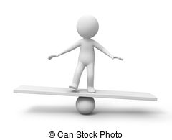
Osmoregulation
The terrestrial environment is very dry (in comparison to an aquatic one). Terrestrial animals are under continual water stress, therefore they are always regulating water losses and gains.
Maintaining water balance is called OSMOREGULATION.

Slide 18
Question 5
The Spinifex hopping mouse is a small Australian mammal. It can survive long periods in a hot desert without drinking water. These animals have a number of adaptations which enable them to avoid dehydration.
List FOUR ways in which a desert mammal such as the spinifex hopping mouse, would lose water.
Answer:
Evaporation from respiratory surfaces
Sweating and panting
Faeces
Urine

Slide 19
Question 5 continued
b. To reduce water loss, many desert mammals are nocturnal. Give ONE other behavioural adaptation that would help a mammal such as this reduce water loss and explain how it would help.
Answer:
Living in burrows with other mammals- increases humidity, reducing water loss.

Slide 20
Question 5 continued
c. When comparing the kidney of a spinifex hopping mouse with that of a similar sized mammal which is not adapted to an arid environment, state ONE difference you would expect to find.
Answer: long Loop of Henle
d. Explain how the difference in kidney structure you have given above would help the spinifex hopping mouse survive in a dry environment.
Answer: increases salt gradient, allows for greater water absorption

Slide 21
Osmoregulation in aquatic animals
Q6 Explain the problems that a bony fish experiences in maintaining water and salt balance in seawater and explain how the fish solves these problems.
(10 marks) [WACE 2017 Ext Response Q39b]
Answer in 2 parts: problems experienced , then solutions.

Slide 22
Problems up to 4 marks, any of the five points:
  The salt concentration of body/body fluids is lower than in seawater OR the salt concentration in seawater is higher than in body fluids/blood.
  Fish blood/body fluids are hypotonic OR seawater is hypertonic.
  Therefore fish loses water to seawater
  Because the water flows from low salt concentration to high salt concentration,
  By osmosis

Slide 23
Solutions up to 6 marks, any of the following points:
  Osmoregulation
  The fish drinks seawater (to replace lost water)
  But takes in salt as well (with the seawater)
  Excess salt is removed
  Actively excretes/removes salts
  Salt is secreted in gills
  Small volume of urine (conserves water)
  Urine is concentrated
  Kidneys have few/small glomeruli (produces smaller volume of urine)

Slide 24
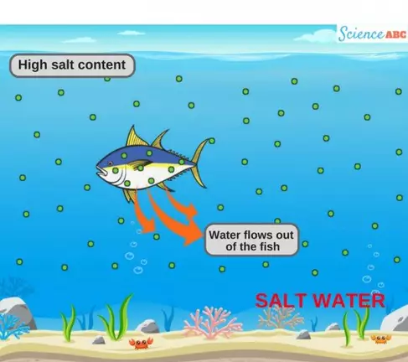
Drinks water
Conc. Low volume urine [urea]
Salt actively secreted by gills
Sea water is hypertonic (greater salt concentration) to the fishes body tissues.

Slide 25
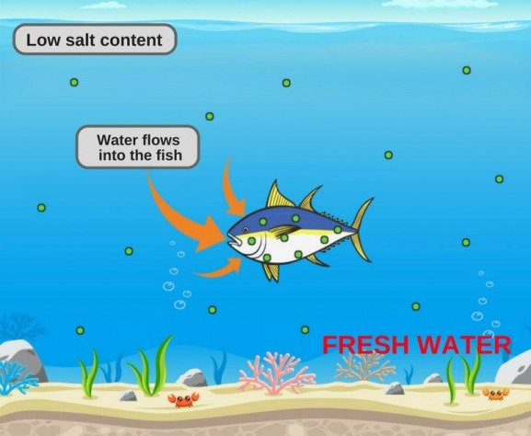
Fresh water is hypotonic (lower salt concentrations) to the Fish body tissues.
Rarely drinks
Dilute high volume urine [ammonia]
Actively absorbs salts in gills

Slide 26
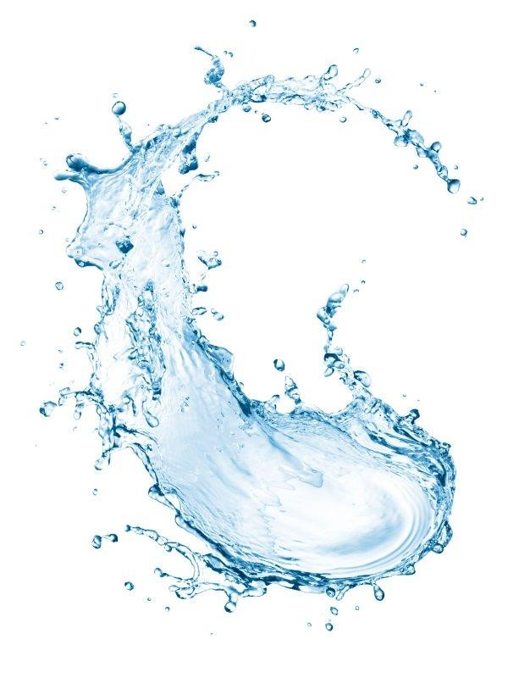
Nitrogenous waste- it’s all about water availability!

Slide 27
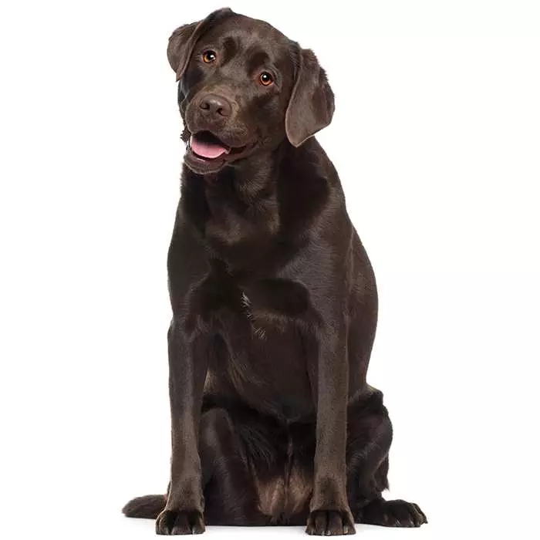
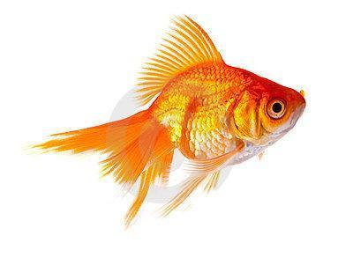
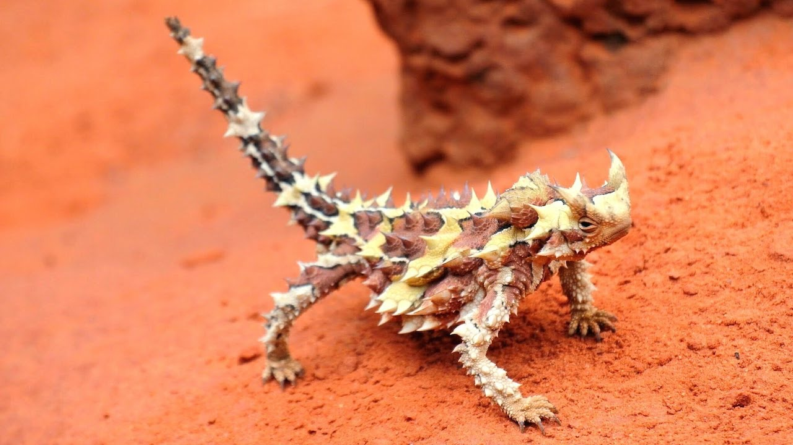
Nitrogenous Waste Question 7:
Q39 a 2016 WACE Extended Response
“Name the type of nitrogenous waste produced by fresh water fish, a dog and a desert lizard. Explain how these relate to the availability of water in each animals environment and the benefits & costs of each type of waste to each animal.”

Slide 28
Animal | N-waste | Availability of water | Benefits | Costs
Fresh- water fish | AMMONIA | HIGH | LOW ENERGY REQUIREMENT | AMMONIA IS HIGHLY TOXIC
Dog | UREA | MODERATE | MODERATE TOXICITY SO CAN BE STORE FOR SHORT PERIODS OF TIME | MODERATE ENERGY COST TO PRODUCE, REQUIRES WATER
Desert lizard | URIC ACID | LOW | NON-TOXIC, CAN BE STORED FOR LONG PERIODS OF TIME. LOW WATER REQUIREMENT. | VERY HIGH ENERGY COST
Notes:
In summary book

Slide 29
Homeostasis and Plants
Plant growth hormones regulate plant activities in response to environmental stimuli.
Temperature changes are also a major factor, for:
Seed germination
Growing seasons
Flowering and seed dispersal
However, we are not concerned with this for Unit 4. What you need to know are the adaptation of XEROPHYTES and HALOPHYTES.

Slide 30
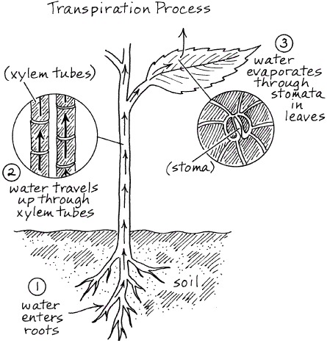
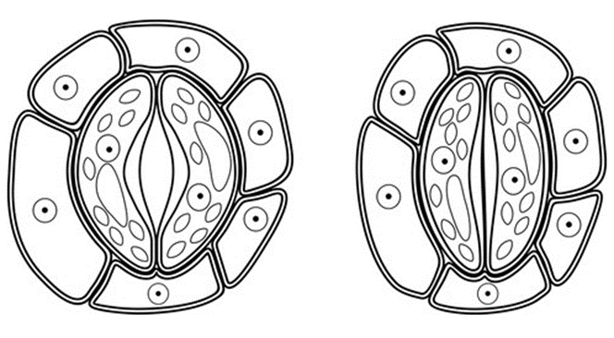
Firstly- lets review stomatal function.
Stomates allow gases to enter and leave the leaf.
Open
Closed
Guard cells are turgid: ‘bean’ shape.
Allows gases in and out of leaf
Guard cells are flaccid, inner membrane close against each other.
No gas exchange.

Slide 31
Arid Environments
Question 8. Which of these leaves represents a xerophyte? Give reasons for your answer.
No stomata on upper epidermis
Thick cuticle
Sunken stomata

Slide 32
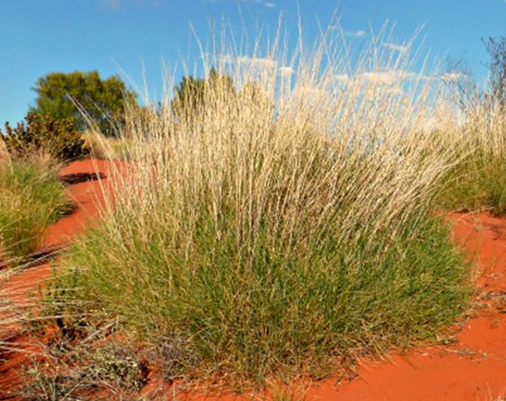
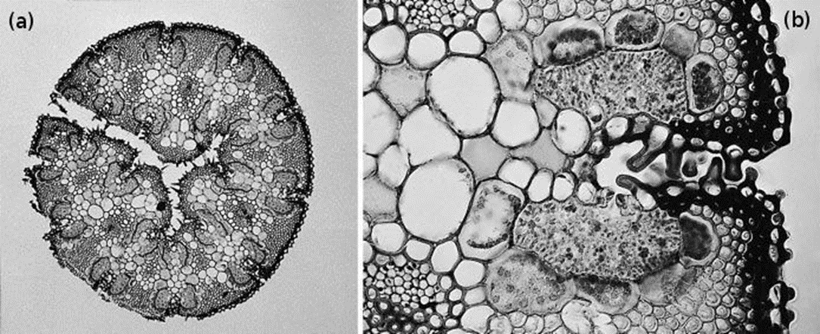
Q9: Spinifex Grass What adaptations can you see that help to prevent water loss?
Curled leaf
Hairs trap moisture increasing humidity around stomata
Stomata on upper epidermis are sunken
Air trapped inside the leaf is humid, reducing water loss

Slide 33
Question 10: WACE 2018 Extended Response
Discuss how a xerophyte minimises water loss while still allowing for gas exchange. (10 marks)
Firstly define the topic:
How do plants lose water? Where does gas exchange occur? [4 marks]
Secondly discuss how a xerophyte minimises water loss while still allowing for gas exchange. [6 marks]
TIP: don’t just list things. Give an example and then say WHY it minimises water loss.
6 marks= 3 examples worth 2 marks each.

Slide 34
How gas exchange and water loss occurs: 4 marks
gas exchange occurs through stomata
stomata need to be open (for gas exchange to occur)
(a lot of) water is lost through open stomata
water is lost through transpiration/evaporation
Minimisation of water loss by a xerophyte while still allowing for gas exchange: 6 marks= 3 examples explained [2 marks each]
1. Stomatal activity:
stomata only open at night/close during the day
temperature is usually cooler at night/no solar radiation
open when water loss is least/closed when water loss is greater

Slide 35
Continued from previous slide
2. Stomatal adaptations
stomata are sunken
surrounded by moist/humid air
hair in stomatal pits/hair on leaves
helps to trap moist air which reduces evaporation OR
stomata are on underside of leaf
reduced light/energy absorption reduces evaporation OR
reduced number of stomata
decrease points of water loss when open

Slide 36
Previous slide continued
3. Leaf adaptations/changes
roll leaves to trap moisture
reduce number/size of leaves/dropping of leaves (deciduous)
reduce number of stomata/reduced size of stomata
(these) reduce unnecessary water loss/the number of open stomata OR
adjust position of leaves (vertical leaves)
reduce light intensity/absorption (which would increase transpiration)
reduces transpiration (and therefore water loss)
keeps leaf cooler (reduces evaporation) OR
thick leaf cuticle
ensures that water is only lost through open stomata

Slide 37


Slide 38
Infectious Disease
Understand the ways in which infection, transmission and spread of disease occur in vector-borne diseases
Part Two:
Infectious Disease
Zoonoses
Bacteria
Fungi
Protists
Viruses
Spread of disease
Management Strategies

Slide 39
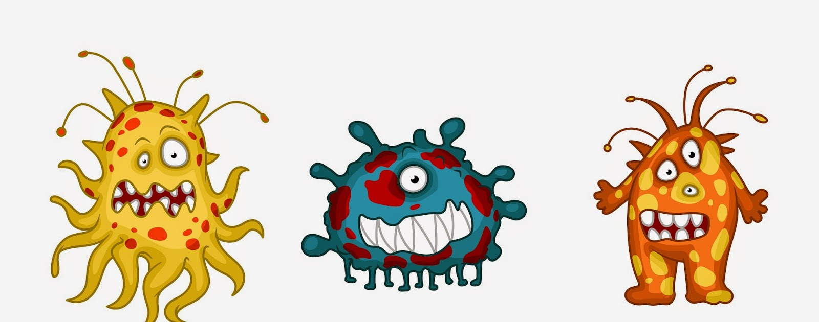
What do you know?
Question 11:
State how infectious diseases differ from other types of diseases. (2 marks)
Communicable- can be passed on to other people
Caused by pathogens

Slide 40
Disease | Organism causing the disease | Organism affected by the disease
Tuberculosis | BACTERIA | HUMAN
Crown Gall | BACTERIA | PLANTS
Chytridiomycosis | FUNGUS | FROG
Phytophthora dieback | PROTIST | PLANTS
Influenza | VIRUS | HUMAN
Malaria | PROTIST | HUMAN

Slide 41
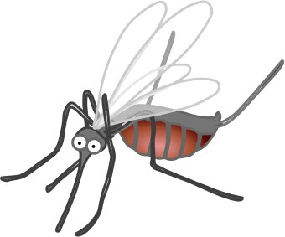
Q 13. Malaria is common among people living at low altitudes in tropical regions but is much rarer at higher altitudes, where the temperature is cooler. Global climate change is predicted to increase the risk of malaria transmission at higher altitudes in tropical regions. Explain why.
(4 marks)

Slide 42
(Malaria is) Transferred by mosquito/Mosquito vector/Anopheles
Mosquito thrives in a warm environment/Is restricted to warm environment OR/IS rare in cooler environments/at higher altitudes
(Global climate change will) increase temperature at higher altitudes
Mosquito will spread to higher altitudes or will increase in abundance at higher altitudes OR will be more active at higher altitudes
Mosquito will take the disease with it when it spreads OR people are more likely to be bitten if mosquitoes are more abundant/more active
(Higher temperature) Will speed up the life-cycle of the pathogen/ Plasmodium/ protozoan
This will increase the abundance of the pathogen
Greater abundance of pathogen, means the risk of transmission is higher

Slide 43
Q14. Exam Extended Response
Malaria is a disease caused by infection with a parasite. Malaria is widespread in many tropical and developing nations. It is the major cause of death in the Asia-Pacific region, infecting around 500 million people per year.
Describe the lifecycle of the Malaria parasite. Include the symptoms and treatments for Malaria in your discussion.
(10 marks)

Slide 44
Describe the lifecycle of the Malaria parasite.
Malaria is caused by a protist (Plasmodium) which is transmitted through the bite of a female mosquito.
Zygotes of Plasmodium develop into sporozoites in gut of a female mosquito and then migrate to salivary glands.
Mosquito bites and feeds on human blood (intermediate host), injecting saliva with sporozoites into bloodstream. Sporozoites move to the liver.
Sporozoites reproduce asexually in the liver cells and produce merozoites. These merozoites enter the bloodstream.
Merozoites infect blood cells and multiply, infecting more blood cells.
Some merozoites can form male and female gametocytes (for sexual reproduction) that are also released into the bloodstream
The infected human host is bitten by another mosquito. Gametocytes enter the mosquitoes gut, mature into gametes and fuse to form zygotes.

Slide 45
Include the symptoms and treatments for Malaria in your discussion.
Malaria causes severe illness including (must list at least 2);
flu-like symptoms
sweating
fever
shaking
chills
pain in muscles and joints
headache
diarrhoea
nausea
Haemolytic anaemia (anaemia due to red blood cell death/loss)

Slide 46
Include the symptoms and treatments for Malaria in your discussion.
There is no vaccine for malaria. Anti-malarial medication prior to visiting affected regions should be taken. Preventing mosquito bites by keeping covered and using repellent.
OR
Malarial drugs must be taken as soon as symptoms are diagnosed. Combination of antibiotics and quinine-based medications. Medication based on type of Plasmodium species (five cause malaria).

Slide 47
WACE 2018 Short answer question
15a.Malaria and tuberculosis are infectious diseases of humans. (a) Malaria is caused by a protist. Describe the main structural features of protists. (4 marks)
Eukaryote
Membrane bound organelles
Nucleus OR Nuclei (may be more than 1)
Microscope/small
Cilia/flagella/psueodopodia
May have cell wall OR protective outer layer
We’ll leave the next 2 as we’ve covered them earlier or in the summary book.
15b.Describe how malaria is transmitted from an infected person to an uninfected person. (4 marks)
15c.Outline two distinctly different methods of controlling the spread of malaria. (4 marks)

Slide 48
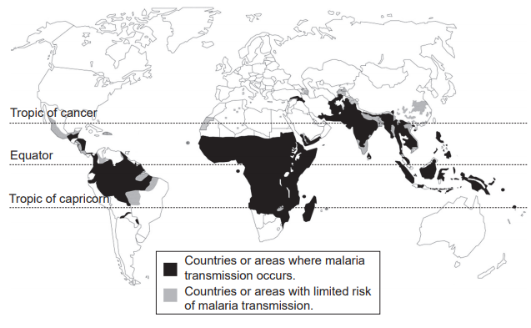
Question 15 continued
The map below shows the worldwide distribution of malaria. Malaria is present in those areas that are shaded.
15d.Describe the distribution of malaria. (3 marks)
rarely occurs above or below the tropic of cancer or the tropic of capricorn respectively
centered on the equator/occurs mainly between the tropic of cancer and the tropic of capricorn
most countries either have malaria transmission or not
very few areas are at limited risk of malaria transmission
refers to any specific country or area where malaria transmission does occur
states any environmental or economic factor regarding temperature and rainfall and malaria transmission

Slide 49
Q15 continued
15e. Unlike malaria, tuberculosis occurs throughout the world. Explain why tuberculosis is much more widely distributed than malaria. (5 marks)
different types of transmission
tuberculosis is caused by bacteria
transmitted from person to person/no vector involved
(tuberculosis) transmitted by close contact/droplets/sneezing
therefore (potentially) spreads (readily) to wherever there are people
modern transport/movements of people helps spread/tuberculosis asymptomatic
malaria is transmitted through vector/mosquitoes/transmitted indirectly
distribution of vector influences distribution of disease or distribution of malaria reflects distribution of (Anopheles) mosquito that transmits it/vector

Slide 50
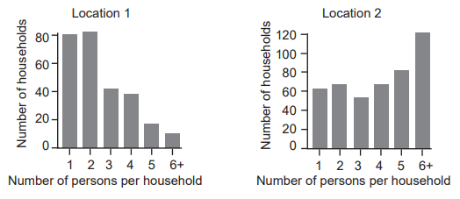
Q16. Influenza
A group of biologists developed a model for predicting the spread of influenza in human populations. As a part of this, they collected data on the number of individuals per household in two locations, which are shown in the figure below.
WACE 2017
Notes:
Application question – can be applied to other respiratory/airborne viruses eg Covid-19

Slide 51
Previous slide continued
Compare the number of people per household in the two locations. Use data from the figure to support your answer. (4 marks)
(On average) location 2 had more people per household or location 1 had fewer people per household.
In location 1 most households had 2 people or 1 or 2 people or there were more households with 1 or 2 people than in location 2.
In location 1 very few households had 6 people or households with 6 people were the least common.
In location 1 there was a (sharp) decline in numbers after 2 people per household.
In location 2 most households had 6 people or had 5 or 6 people.
In location 2 households with 3 people were the least common.
In location 2 there more households with 3, 5 or 6 people than in location 1.
For location 1, any accurate quote of data which gives both the number of dwellings and the number of persons per household.
For location 2, any accurate quote of data which gives both the number of dwellings and the number of persons per household.
The range in the number of people per household was the same for both locations
Notes:
READ question- note the instructional verb.

Slide 52
Previous slide continued
b. Explain why data on the number of people per household are relevant to the development of a model for predicting the spread of influenza in human populations. (4 marks)
Influenza is spread through close contact
If one member of the household has the disease, there is a (high) risk that it will be transmitted to other people in the household
In location 2/locations with large households more people are likely to be infected or in location 1/locations with small households fewer people are likely to be infected
Infected individuals can spread the disease to individuals from other households
The more infected people there are, the greater the chances that an uninfected person from another household will come into contact with them or the fewer infected people there are, the lower the chances an uninfected person from another household will come into contact with (if all else is equal)
The rate of transmission/spread (outside of the household) will also depend on the population size/density/vaccination or other factors.
Notes:
Application of spread of pathogens

Slide 53
Previous slide continued
c. Can influenza be treated with antibiotics? Explain why or why not. (4 marks)
No (influenza cannot be treated with antibiotics) – 1 mark
Any 3 for 3 marks
Influenza is caused by a virus
Antibiotics only work on bacteria
Antibiotics work by targeting structures that are present in bacterial cells or antibiotics work by targeting structures that are not present in a virus
Specific details – e.g. antibiotics target cell wall of bacteria or ribosomes of bacteria (protein synthesis)
Antiviral drugs are used to treat viral diseases
Antiviral drugs disrupt the life cycle of the virus

Slide 54
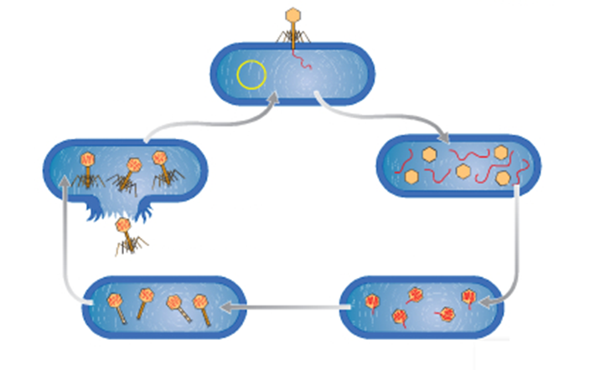
Q17.Viral Reproduction: LYTIC Phase
1. Virus particle binds to the wall of the host
Viral DNA enters cell’s cytoplasm
2. Viral DNA directs cell machinery to produce viral proteins & copies of viral DNA
5. Host cell undergoes LYSIS & dies. Infectious viral particles are released.
Viruses can remain dormant, this is called the LYSOGENIC Phase.
3. Viral proteins are assembled into ‘coats’ → DNA packaged inside
4. Tail fibres & other components are added to coats
Notes:
L:earn this- can be applied to any virus question. (They all reproduce in the same way)

Slide 55
WACE 2017 Extended Response Question
3 parts to this question!
Q 18. Describe the life cycle of the pathogen that causes chytridiomycosis (amphibian chytrid fungus disease) and discuss the impact that the pathogen has on the host and the mode of transmission of the pathogen.
(10 marks)

Slide 56
Describe the life cycle of the pathogen that causes chytridiomycosis (amphibian chytrid fungus disease) up to 5 marks
Fungus/Thallus produces (zoo)spores
Spores are produced by asexual reproduction
(Zoo)spores are released into water (or reinfect host)
(Zoo)spores swim
Encounter/invade host Invade skin cell/surface layer of skin
Zoospores develop into a thallus
Thallus matures (into sporangium)

Slide 57
Discuss the impact that the pathogen has on the host. Any three for 3 marks
Nervous system:
  affects frog's behaviour/sit out in sun
  sluggish, no appetite
  has its legs spread slightly away from itself
Part of frog's skin that has keratin:
  Causes skin cells to shed/thicken/harden
  Disrupts function of skin cells
  Frogs use skin to exchange gases and water and salts
  Leads to osmotic problems
Frogs die

Slide 58
discuss …the mode of transmission of the pathogen. Any two for 2 marks
Contact with contaminated water/water containing zoospores
Direct contact between frogs
Humans or other animals (e.g. ducks) (may spread over land)
Transmission outside of water is not well known

Slide 59
The Spread of Disease and Management Strategies
These questions are nearly always application questions.
This means you will be asked to apply your knowledge of disease to a context (a particular disease outbreak situation eg a cholera outbreak).
Therefore you must be familiar with:
Various diseases (see syllabus)
How diseases spread
Ways to prevent transmission
Ways to minimise an outbreak

Slide 60
2020 WACE short answer question 31
Q20. The pathogen that causes jarrah dieback is a type of protist.
(i) List two structural features of protists that are not found in bacteria. (2 marks)
  protists are eukaryotes/have a nucleus
  protists have membrane-bound organelles/mitochondria
  cell walls of protists are made of cellulose (not peptidoglycan)
(ii) List two structural features of protists that are not found in fungi. (2 marks)
  • protists are (usually) unicellular
  • protists (often) have flagella (except in Chytrid zoospores)/cilia
  • cell walls of protists (when present) are made of cellulose (not chitin)

Slide 61
2020 WACE short answer question 31 continued
In order to prevent the spread of jarrah dieback, vehicles are banned from driving on some tracks when the soil is wet.
(b) Explain how this can prevent the spread of jarrah dieback. (4 marks)
disease is spread (from plant to plant) by spores/zoospores
spores/zoospores are more active when it is wet
vehicles pick up more (contaminated) soil when it is wet; (therefore) risk of transmission/spread is greater when the soil is wet
vehicles can spread disease/spores/zoospores over a large area

Slide 62
2020 WACE short answer question 31 continued
(c) Describe how the tuberculosis pathogen is transmitted to a new host. (2 marks)
pathogen is in air/airborne or affected individuals breathe out pathogen/droplet
new host breathes in/inhales pathogen
(d) Describe the impact that the tuberculosis pathogen has on the host. (2 marks)
infects lungs/respiratory system
causes coughing/lung irritation/breathing problems/tuberculosis
sometimes does not cause symptoms or takes time for symptoms to develop or can infect brain/nervous system/tissue other than the lungs
(e) Explain how vaccination helps to control the spread of tuberculosis. (4 marks)
vaccination introduces weakened/harmless version of a pathogen into body
this stimulates production of antibodies/stimulates an immune response
vaccinated individuals become immune or do not catch the disease
higher the proportion of the population that is immune, the greater the protection (or the converse)
because infected individuals do not/rarely come into contact with susceptible individuals (or the converse)
herd immunity/high immunity protects susceptible individuals

Slide 63
Q21. The development of vaccines has enabled highly contagious diseases to be eradicated from the global population.
Describe how immunisation programs have been successful in stopping the spread of virulent pathogens. (2 marks)
Reducing the rate of infection of virulent pathogens.
Eradicating some diseases by completely stopping spread through mass immunisation programs
Explain why immunisation programs have been compromised in some communities around Australia. (2 marks)
More people are choosing NOT to have their infants/children immunised due to fear of serious illness from side effects and misinformation.
The growing number of non-immunised individuals weakens the ‘herd immunity’ and certain diseases can be reintroduced into a population.

Slide 64
Q22. White spot disease is a highly-contagious viral disease in prawns. It is found in parts of Asia, America, Africa and the Middle East, but generally not in Australia. A recent outbreak has, however, occurred in several prawn farms on a river in Queensland. Explain two measures that could be taken to reduce the risk of white spot spreading from the affected farms to other parts of Australia.
(4 marks)
Kill all the prawns in affected farms
Chlorinate/clean water at affected farms (killing the virus)
Quarantine all effected prawns and equipment
Physical barriers to prevent virus moving into environment
Vaccinate prawns
Delay restocking affected farms- allow virus to die off
Kill prawns at nearby unaffected farms- no hosts for any escaped viral particles to enter.

Slide 65
