Slide 1

Harnessing the Power of Diversity & Inclusion through the ECU D&I CMM
School of Business & Law

Slide 2

“…without a modern, diverse and inclusive workforce, one that not only represents differences but where people of all identities can contribute as full and valued members, public sector organisations
will fail to leverage the wealth of benefits offered.”
Lundy, J. (2022, January 19). Optimising inclusion and diversity in the public sector: an evidence-based approach. The Mandarin. https://www.themandarin.com.au/178943-optimising-inclusion-and-diversity-in-the-public-sector-an-evidence-based-approach/

Slide 3

Why focus on Diversity & Inclusion?
Having a truly diverse and inclusive workforce offers organisations:
Alternative perspectives
Greater creativity
Improved problem-solving
Robust decision-making processes
Increased productivity and performance
Meeting workforce and societal expectations

Slide 4
ECU D&I Research
“Research shows that, companies that embrace DE&I are 70% more likely to capture new markets, and 75% more likely to see ideas become productized. Meanwhile, diverse teams, managed inclusively, have also been found to be better at solving complex challenges. Companies with above-average diversity performance report 19% higher innovation revenue, while studies have also shown that diverse and inclusive teams make better decisions 87% of the time.”
WBCSD (2022). Diversity, equity and inclusion in the workplace: The journey to leading practices. https://www.kornferry.com/insights/featured-topics/diversity-equity-inclusion/the-journey-forward-dei-in-the-workplace

Slide 5
The Capability Maturity Model
Why use one?
Capability maturity models (CMM’s) identify relevant dimensions as well as typical maturity levels corresponding to different stages of organisational development. They are particularly useful to provide a structured framework to see where you are, where you want to be and help inform strategies to address the gaps.
CMM’s allow organisations to:
    Self-assess their strengths and weaknesses
    Identify the organisation’s current and desired maturity levels
    Plan for continuous improvement

Slide 6
Why use the ECU D&I CMM?
Our Model
The ECU D&I CMM:
  Offers a practical, evidence-based approach to ensuring D&I are embedded throughout the organisation
  Recognises inclusion as an undervalued and rarely mastered organisational capability
  Provides the ability to address ‘next practice’ D&I providing practical implementation guidance
  Supports organisations with a range of resources to assist with conducting self-assessments

Slide 7





ECU D&I Maturity Levels
4
transformatiVE
At Level 4, D&I is next-practice orientated. There are expanding conceptualisations of diversity, with inclusion as a core element.
integrative
3
At Level 3 D&I reflects interactions between people and processes, with inclusion becoming an integral and integrating component.
managerial
2
At Level 2, diversity is primarily for organisational advantage. Inclusion is espoused, not enacted.
ECU
D&I CMM Dimensions
compliance
Drivers &
Focus
At Level 1, D&I is legalistic, HR-dominant and reactive. It is largely (if not solely) related to diversity.
1
Responsibility & Leadership
D&I
Measurement
Mechanisms & Defining Features

Slide 8
What Is Involved?
Conducting an ECU D&I CMM Self-Assessment
The assessment process has four steps:
  Preparing for the self-assessment (decide on the scope of the assessment and who needs to be involved)
  Conducting the self-assessment (using the Excel-based tool available, assess the current maturity levels for each dimension using organisational evidence and set realistic target ratings)
  Analysing and reporting the results (review the radar chart produce by the self-assessment tool and review the evidence collected, the gaps and alignments)
  Planning for continuous improvement (decide on where to invest resources for the greatest impact)

Slide 9
What support do we need to move forward?
Sign-off
Sign-off on the scope of the self-assessment (organisational level, department level)
Agreement
Agreement to allow managers across the organisation (depending on the scope) to participate in the self-assessment
Approval
Approval to involve employees in the process (especially those who represent diverse groups) to check our assumptions about people’s experiences of D&I in our organisation

Slide 10
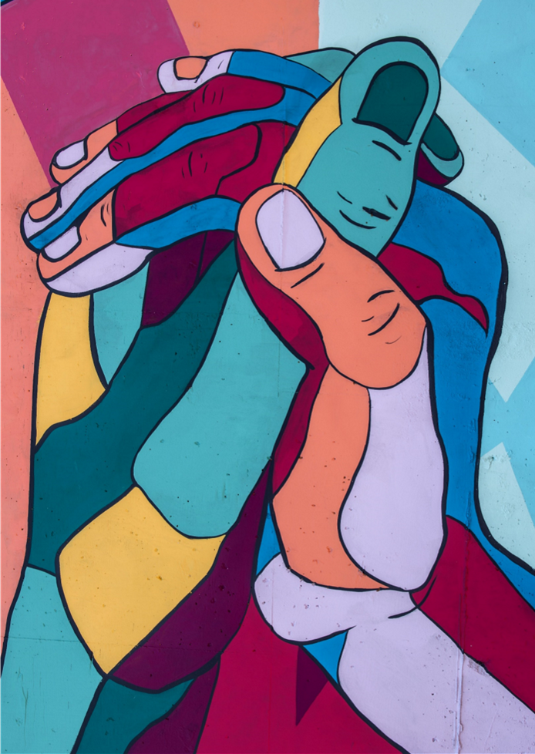
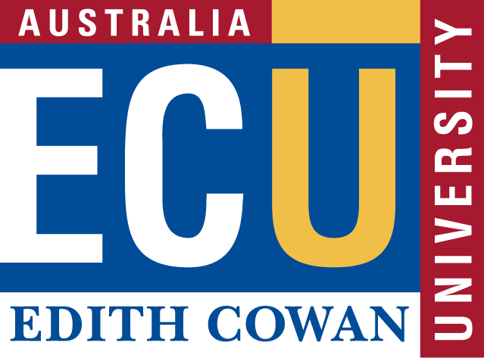
Questions?
School of
Business & Law

Slide 11
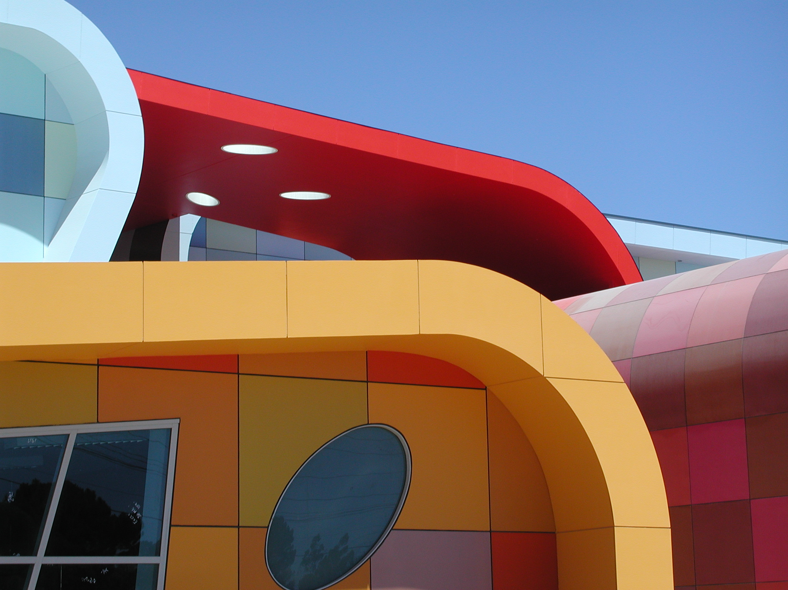
ECU
Diversity & Inclusion Capability Maturity
Model
This resource is based on the ECU Diversity & Inclusion Capability Maturity Model (ECU D&I CMM) first introduced as Figure 1 in Lundy, J., Keast, R., Farr-Wharton, B., Omari, M., Teo, S., & Bentley, T. (2021). Utilising a capability maturity model to leverage inclusion and diversity in public sector organisations. Australian Journal of Public Administration, 80(4), 1032–1045 https://doi.org/10.1111/1467-8500.12521. © 2021 Institute of Public Administration Australia.
For more information contact
Dr Judy Lundy
School of Business and Law
Edith Cowan University
j.lundy@ecu.edu.au
+61 8 6304 5140
*
*© 2021 Institute of Public Administration

