Slide 1

12 ATAR Biology Revision Seminar Unit 3
Rachel Donnelly 2024

Slide 2
The golden opportunity you are seeking is in yourself.
It is not in your environment; it is not in luck or chance, or the help of others; it is in yourself alone.
--- Orison Swett Marden
Notes:
2 booklets for each unit, summary book has extra details in it- ie diagrams

Slide 3
Feedback from the SCSA Examiners Board 2016-2022
Read questions carefully! Often students lose marks by not answering the question fully or by misinterpreting the question. (see SCSA Glossary of Key Words in the formulation of questions. Appendix 1)
  Know the question verbs. for example ‘compare’, you should systematically compare the similarities and differences.
Use formal and precise language.
Use science terminology. Using the correct science words demonstrates your understanding.
Be clear in your answers- just state the answer, especially in the short answer section where time and space is at a premium.
Do not repeat or rephrase the question.
Annotate diagrams (label them), lines need to point directly to structure being labelled and refer to them in your written answer, this demonstrates your understanding.
Spend time planning your answers to extended response questions.
  Dot points, sub-headings are acceptable
Notes:
Page 3 workbook,

Slide 4
Feedback from the SCSA Examiners Board 2016-2023
In 2019 questions changed to become more open-ended or required the application of knowledge (not just factual recall). You need to be prepared to apply your knowledge to a range of contexts. Therefore:
You need to develop an in-depth understanding of important concepts.
Concepts such as:
  Scientific method: validity and reliability.
  Replication of genetic material (eg meiosis).
  Protein synthesis.
  Variation.
  DNA technology- in particular recombinant DNA, DNA identification.
  Natural selection.
  Conservation planning- use of population dynamics and biogeography
  Homeostasis- maintaining internal environment.
Notes:
Students had breadth of knowledge but not depth to obtain full marks

Slide 5
Science Inquiry Skills
Writing a hypothesis: The independent variable changed the dependent variable by...
  A hypothesis states a relationship between variables.
  A prediction is what you expect to happen if your hypothesis is supported.
An independent variable is the factor chosen and manipulated by the experimenter.
A dependent variable is the factor responding to the independent variable. (It is dependent upon the independent variable) The experimenter collects results about this variable.
A Controlled variable is the factor which is the same for all the subjects being tested. It stays the same for the whole experiment.
Notes:
In summary booklet

Slide 6
TIME is the dependent variable
Table 1: Volume of a marble and speed.
VOLUME is the independent variable
 | Time taken to roll 2 metres (secs) |  |  |  | Speed (ms⁻¹)
Marble volume (cm³) | trial 1 | trial 2 | trial 3 | average
20 | 30 | 32 | 31 | 31 | 0.06
40 | 23 | 20 | 24 | 22.3 | 0.08
SPEED is included because this is the value used for comparison of data.
Notice UNITS OF MEASUREMENT are found in the titles NOT next to the data.
Notes:
Summary booklet

Slide 7
Why you can’t use “to make it a fair test” as an answer!
This is not a valid answer because it doesn’t show any understanding of the concept of a fair test.
A FAIR TEST is one that has VALIDITY and RELIABILITY.
An investigation is VALID if it tests what it is supposed to test.
  Validity is increased when variables are controlled. Any variable that is not the independent or dependent should be controlled.
RELIABILITY means that if the same experiment is repeated many times the same results will be collected.
  Reliability can be increased by repeating the experiment many times or increasing the sample size.
Notes:
P4 work book

Slide 8
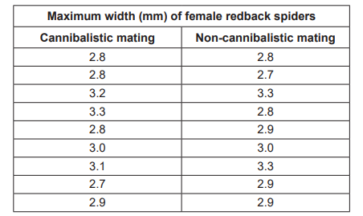
Science Inquiry Question 1.
Female redback spiders sometimes eat their mates (cannibalistic mating) but not always (non-cannibalistic mating). A biologist determined the size (maximum width) of female redback spiders in cannibalistic and non-cannibalistic matings.

Slide 9
Independent variable:
Whether the female cannibalises her mate or not.
b. Dependent variable:
  Size of female redback spider
c. Hypothesis:
  “If female redbacks are large then they are more likely to cannibalise their mate”
d. Controlled variables
  Species of spiders, environmental conditions (temperature etc), diet (food source, amount)
e. Reliability
  Repeat trials, larger sample size

Slide 10
Unit 3: Continuity of the Species
Learning outcomes: by the end of this unit, students:
understand the cellular processes and mechanisms that ensure the continuity of life, and how these processes contribute to unity and diversity within a species
understand the processes and mechanisms that explain how life on Earth has persisted, changed and diversified over the last 3.5 billion years
understand how models and theories have developed over time
use science inquiry skills to design, conduct, evaluate and communicate investigations into heredity, gene technology applications, and population gene pool changes
evaluate, with reference to empirical evidence, claims about heredity processes, gene technology, and population gene pool processes, and justify evaluations
communicate biological understanding using qualitative and quantitative representations in appropriate modes and genres.

Slide 11
Understand the cellular processes and mechanisms that ensure the continuity of life, and how these processes contribute to unity and diversity within a species
PART ONE
Structure of DNA
DNA Replication
Genetic Code
Protein Synthesis
DNA Technologies
  Genetic engineering techniques
  DNA sequencing
  DNA profiling
  Recombinant DNA
  Transgenic organisms
Continuity of Life
  Cell reproduction
  Mutations
  Patterns of Inheritance

Slide 12
DNA
Draw a nucleotide.
Base
Phosphate
Adenine
Thymine
Cytosine
Guanine
Sugar molecule

Slide 13
Adenine base
Thymine Base
Hydrogen bonds join bases together:
adenine-thymine (2 H-bonds)
guanine-cytosine (3 H-bonds)
Phosphate-sugar backbone: phosphodiester bonds.
Guanine base
Cytosine base

Slide 14
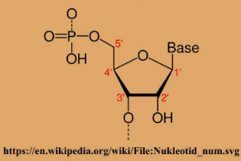
5’/3’ ??????
Phosphate group
5’ Carbon
DNA has ‘directionality’.
Described as 5’ to 3’ (5-prime to 3-prime)
The 5 and 3 relates to the C on the 5 carbon atoms of the sugar ring. (numbered 1-5)
The 5’ end starts with a phosphate group
The 3’ end finishes with a sugar
Adenine/thymine/ cytosine/guanine
3’ Carbon on sugar ring
Next phosphate group
Notes:
In summary book

Slide 15
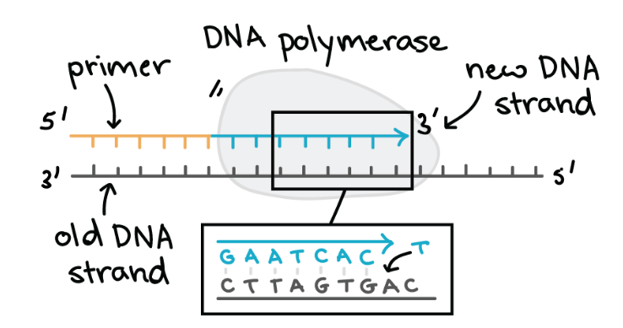
Why is this important?
DNA polymerase only works in 1 direction.
Can only add nucleotides on the 3’ end.
Read UP, Write DOWN
Writing the new strand by adding nucleotides to the 3’ end
Reading the original strand 3’ to 5’
Graphic from Khan Academy

Slide 16
DNA Replication: the basics!
What is the purpose of DNA replication?
  To reproduce 2 identical strands of DNA
But why does the body need more DNA?
  Essential for cell division during growth or repair of damaged tissues.
  DNA replication ensures that each new cell receives its own copy of the DNA.
Notes:
No writing just think about answer

Slide 17
DNA Replication Question 2
The process of DNA replication requires enzymes.
Identify the two (2) main enzymes that attach to the DNA molecule and describe their function. (4 marks)
DNA helicase (1) unwinds/unzips the DNA molecule so other molecules can attach to it (1)
RNA primase (1) attaches short sequence of RNA (primer) to mark the ‘start’ point (1)
DNA polymerase (1) binds to the DNA and synthesises a new complimentary strand of DNA (1) from the 5’ to 3’ end.
Notes:
P6 work book

Slide 18
DNA Replication Question 3
From the 2016 WACE Exam Extended Response Section
“Describe the structure of DNA (5 marks) and
the main steps in DNA replication in a cell.(5 marks)”
(10 marks)
[ 2022 q37Cell reproduction is needed for growth and to replace damaged cells. It involves DNA replication followed by mitosis. (a) Describe how a DNA molecule replicates itself and the process of mitosis. (10 marks)]
Notes:
Further detail on summary book

Slide 19
Official WACE marking key- DNA Replication. Pretty overwhelming!
Any 5 of the following:
The (double-stranded) DNA unwinds/separates or the two strands (of nucleotides) separate
Each of the two DNA strands/molecules is copied/acts as a template/becomes half of the new DNA molecule.
The new strand/molecule is complementary to the original/template strand
(The enzyme) DNA polymerase synthesizes the new DNA strand/molecule/adds nucleotides to the new strand
Helicase unwinds the DNA/double helix/separates the DNA strands
The (hydrogen) bonds between adjacent nucleotides/strands are weak and easily broken
The process is described as semi-conservative
Synthesis is continuous one strand (leading strand, 5' to 3’), Synthesis is discontinuous on the other strand (lagging strand)
Synthesis occurs in one direction only or in a 5’ to 3’ direction or DNA polymerase can only add nucleotides to the 3' end or DNA polymerase cannot nucleotides to the 5' end
(Therefore) One strand (5' to 3') is synthesized continuously (leading strand)/one strand (3' to 5') is synthesized in short pieces (lagging strand)
(On the lagging strand) Short stretches of DNA are joined together to form the new molecule
Ligase joins the short stretches of DNA together
DNA polymerase corrects mistakes

Slide 20
The IMPORTANT bits to KNOW about DNA Replication!
DNA helicase unwinds the DNA double helix into separate strands.
Weak hydrogen bonds between (nitrogenous) bases are broken, exposing the bases.
Each single strands acts as a template.
RNA primase marks the start point (primer)
DNA Polymerase adds complementary free nucleotides to the single strand in a 5’ → 3’ direction. (nucleotides added to the 3’ end)
The Leading strand runs towards the replication fork and nucleotides are added continuously.
The Lagging strand runs away from the replication fork and nucleotides are added in fragments.
These fragments are called OKAZAKI fragments.
DNA Ligase fills these fragments to make a complete strand.
DNA replication is semi-conservative (each new strand consists of 1 original strand and 1 new strand.)
Notes:
In summary book- go over key points

Slide 21
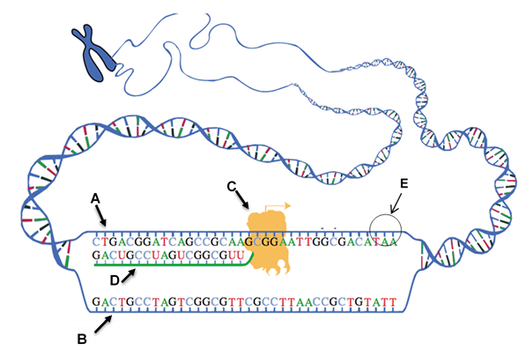
The Genetic Code
A set of rules by which the genetic information in DNA or mRNA is translated into proteins.
Question 4: refer to the diagram below depicting the transcription stage of protein synthesis.

Slide 22
Genetic Code. Question 4 answers
HOW do you know this?
The DNA double helix is only partially unwound.
Only one strand is being copied.
Identify the structures on the diagram above at the areas labelled A – E.
Template Strand
Non-template strand
RNA Polymerase
mRNA
Stop codon/codon

Slide 23
Genetic Code question 4 answers continued
Distinguish between the structures labelled A and B (2 marks)
Template Strand: mRNA is complementary to this strand.
B. Non-template strand: mRNA is a matching copy of this strand.

Slide 24
Genetic Code: Question 5
What is the purpose of protein synthesis?
To produce proteins.
Proteins are important molecules, they are involved in nearly all cellular processes.
The most important proteins are enzymes, biological catalysts that speed up rates of reactions.
There are two processes occurring in the diagram, what are they and where in the cell do they occur? (4 marks)
Transcription: nucleus
Translation: cytoplasm

Slide 25
Genetic Question 5 continued.
Describe the sequence of events from start to finish.(10 marks)
1. Transcription (max 6 marks)
mRNA produced from DNA
mRNA is formed using the TEMPLATE strand
Initiation: RNA polymerase binds to promoter, signalling the DNA to unwind a portion of the double helix.
Elongation: RNA polymerase builds mRNA (moving in a 3’ to 5’ direction but building in a 5’ to 3’ direction), until it reaches the STOP base sequence
Termination: Pre-mRNA is released and DNA zips up
Methylated cap is added to the 5’ end and poly A-tail to the 3’ end.
Introns (non-coding) are removed via splicing

Slide 26
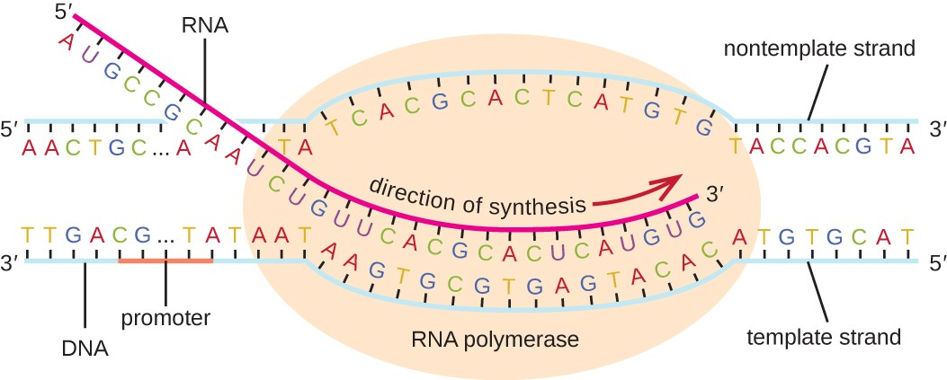
Free nucleotides added to the 3’ end
Begins at promoter sequence, reads from the 3’ to 5’ direction. (READ UP, WRITE DOWN)
Notes:
Note direction: reads 3’ to 5’ but builds 5’-3’ (adds free nucleotides to free prime end)

Slide 27
Genetic Question 4 continued.
2. Translation (any 4 for 4 marks total)
Initiation: Ribosome binds to methylated cap on mRNA
  Ribosome scans to find the Start codon (AUG/methionine)
  Ribosome “reads” the mRNA , selecting tRNA with the complementary anti-codon
Elongation: tRNA brings amino acids to the ribosome
  tRNA anticodon binds temporarily to the ribosome
  Amino acids link to form proteins (or peptide chains)
  The ribosome catalyses the peptide bonds
Termination: when a stop codon (UAG, UAA, UGA) is reached, the polypeptide is released.
  mRNA separates from the nucleus.
  Polypeptide may fold to become protein or join another polypeptide and then fold.

Slide 28
tRNA brings in amino acids
Complementary to mRNA
Ribosome catalyses the peptide bonds
http://hyperphysics.phy-astr.gsu.edu/hbase/Organic/translation.html

Slide 29


Slide 30
DNA Technologies
Biotechnology:
The use of living things to make new products or systems.
Traditional:
The manipulation of crops/animals through “selective breeding”.
Modern (Genetic Engineering):
Changing the genetic sequence of an organism through human use of biotechnology techniques.
Produces: Genetically Modified Organisms OR Transgenic organisms.

Slide 31
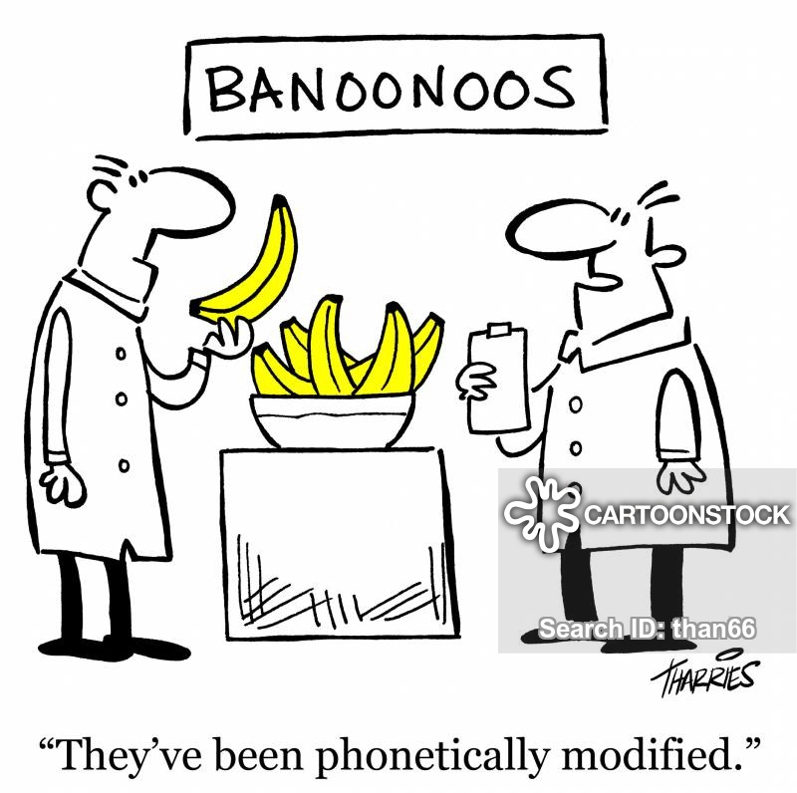
Tools of the Trade!
Biotechnology requires the use of biological “tools”. These are mostly derived from organisms. They are used to:
Synthesising, cutting and pasting DNA
Viewing and analysing DNA
Notes:
In summary book

Slide 32
Question 6: Distinguish between; Cutting DNA, Recombining DNA and Amplifying DNA. (6 marks)
Cutting DNA:
  restriction enzymes “cut” DNA at specific sites (restriction sites)
Recombining DNA:
  DNA ligase is used to “glue” the two restriction fragments together, it catalyses phosphodiester bonds.
Amplifying DNA:
  Polymerase Chain Reaction (PCR) is used to make more DNA. Each cycle doubles the amount of DNA.

Slide 33
Question 7: Same, same but different- notice the two questions below are after the same answer?
WACE 2018: A breeder kept only albino guinea pigs. The breeder put one female and two male guinea pigs in the same enclosure. The female had a litter of offspring. The breeder wanted to know which of the male guinea pigs was the father of the litter.
Explain how biotechnology can be used to determine the father of the litter. (4 marks)
WACE 2016: A number of people who had visited a particular dental practice were later found to be infected with a hepatitis virus. Health authorities suspected that these people had contracted the virus through the dental practice.
 Explain how DNA profiling could be used to determine whether these people had contracted the virus through the dental practice. (4 marks)

Slide 34
Question 7 continued
1 mark each
Create DNA profile (via gel electrophoresis) of the virus in these patients.
Create/obtain DNA profile of hepatitis virus from other sources
Compare the DNA profiles.
If patients contain same/related strains of virus, then it likely came from the dental practice.

Slide 35
Gene Cloning: Question 8. [application of DNA technology concepts]
Among Australia’s key cotton pests is the global insect nemesis of agriculture; Helicoverpa armigera, better known as the bollworm. Since the mid-1990s, Australia’s cotton breeders have begun creating transgenic, or genetically modified, organisms by incorporating genes from a common soil bacterium, Bacillus thuringiensis (Bt). These genes encode for the production of toxic insecticidal proteins.
Name two possible positive outcomes resulting from this genetic modification.
(2 marks)
Outline the sequence of events undertaken to produce the Bt cotton.
(5 marks)

Slide 36
Biotechnology Question 8 continued
Name two possible positive outcomes resulting from this genetic modification.(2 marks)
IMPROVED YIELD – 1
REDUCES THE NEED TO SPRAY INSECTICIDE- 1
Outline the sequence of events undertaken to produce the Bt cotton. (5 marks)
IDENTIFY AND ISOLATE THE Bt GENE – 1
(using a restriction enzyme) EXTRACT/CUT Bt GENE OUT OF DNA ALONG WITH PLASMID/AGROBACTERIUM – 1
(using the same restriction enzyme) SPLICE/LIGATE Bt GENE INTO PLASMID/AGROBACTERIUM- 1
TRANSFER/TRANSFORM/INTRODUCE RECOMBINANT PLASMID/AGROBACTERIUM INTO TISSUE CULTURE OF COTTON- 1
CULTURE/GROW Bt COTTON PLANTS- 1

Slide 37
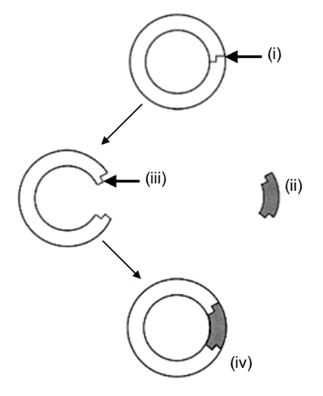
(i) RESTRICTION SITE- PLASMID IS SPLICED BY RESTRICTION ENZYME. (1)
(iii) COMPLEMENTARY STICKY ENDS ALLOW FOREIGN GENE FRAGMENT TO BIND TO PLASMID (1)
Attracted by hydrogen bonds
(ii) THE SAME (1) RESTRICTION ENZYME CLEAVES/SPLICES/CUTS THE FOREIGN GENE SEQUENCE (1)
(iv)DNA LIGASE GLUES/BINDS (catalyses phosphodiester bonds)
DNA FRAGMENT TO PLASMID TO FORM RECOMBINANT DNA (1)

Slide 38
The Continuity of Life: Cell Reproduction
Refer to Summary booklet for information on chromosomes.
So, what are the really important things to know?
  Mitosis: purpose, stages
  Meiosis: purpose, stages
  Mutations: types of.
  Patterns of Inheritance
    Know how to construct a punnet square
    Recognise patterns of inheritance in pedigrees
    Know examples of the types of inheritance
Notes:
In summary book. 2020 WACE exam had a compare the 2 processes in the extended response section! unusual

Slide 39
Cell Reproduction: Question 9.
Question 9: Genetic recombination in eukaryotes occurs via several processes including crossing over and independent assortment during meiosis.
Describe each of these processes and explain briefly how they produce genetic variation.
(4 marks)

Slide 40
Cell Reproduction: Question 9. continued
CROSSING OVER:
PROPHASE 1, HOMOLOGOUS CHROMATIDS TANGLE AND EXCHANGE GENETIC MATERIAL.
CREATING NEW COMBINATIONS OF ALLELES
INDEPENDENT ASSORTMENT:
METAPHASE 1: HOMOLOGOUS CHROMOSOMES LINE UP AT THE EQUATOR INDEPENDENT TO EACH OTHER (RANDOM-NO PARTICULAR ORDER)
THIS LEADS TO RANDOM ASSORTMENT- THE ALLELES SEPARATE INTO GAMETES INDEPENDENTLY; THEREFORE, EACH GAMETE IS UNIQUE (A RANDOM COMBINATION).

Slide 41
A word on variation.
Variation is important because during times of environmental change there is a greater likelihood of some individuals will hold favourable genes that allow them to survive.
Variation is increased by:
the process of meiosis
  Crossing Over- (during prophase 1) allows for genetic exchange of material, again random.
  Law of Segregation- when alleles separate into the gametes this is done independently from other genes (random/in no particular order)
Fertilisation
  ova are fertilised by a random sperm/gamete. It is pure chance as to which gametes meet.
Mutation: the only (and rare) source of new alleles

Slide 42
Mutations
Point v’s Chromosome
Point: single nucleotide
In somatic cells: may affect protein synthesis as sequence of nucleotides is changed.
Chromosome: whole or part of chromosome
Monoploidy: one set of chromosomes,
Polyploidy: more than one complete set of chromosomes, and
Aneuploidy: addition or loss of one chromosome due to non-disjunction.

Slide 43
Patterns of Inheritance
Monohybrid crosses (the most common examples you will see in an exam)
Important to remember:
If a question asks you for evidence or to show working out then use a punnet square.
Show your working out in full. Answers involving punnet square are worth up to 4 marks.
Notes:
Summary booklet

Slide 44
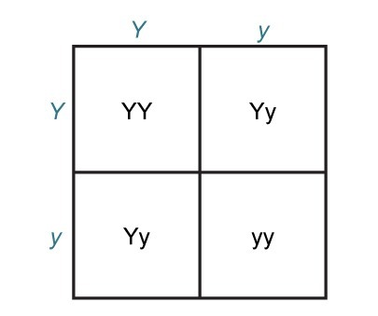
A heterozygous yellow pea plant is crossed with another heterozygous yellow pea plant. What are the possible genotypes and phenotypes of the offspring. Show all working out.
Y= yellow y= green
P: Yellow x Yellow
Yy x Yy
1 mark for the allele key
1 mark for correct parent alleles.
1 mark for correct offspring genotypes
75% (or ¾) Yellow
25% (or ¼ ) homozygous yellow
50% (or 2/4) heterozygous yellow
25% (or ¼) homozygous green
1 mark for correct phenotype & ratios
Notes:
In summary booklet

Slide 45

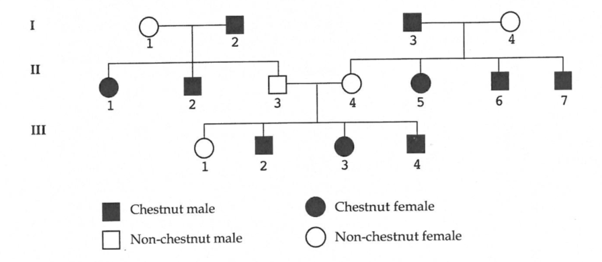
Autosomal recessive
hh
hh
Hh
Hh
Hh
hh
hh
hh
hh
hh
hh
hh
hh
Could be HH or Hh
All “hh” genotype
Either “HH” or “Hh”

Slide 46
Understand the processes and mechanisms that explain how life on Earth has persisted, changed and diversified over the last 3.5 billion years
PART TWO
Fossils
Evidence for Evolution
Phylogenetic Trees
Natural Selection
Changes in allele frequency
Speciation
Evolution
Extinction
Environmental Conservation

Slide 47
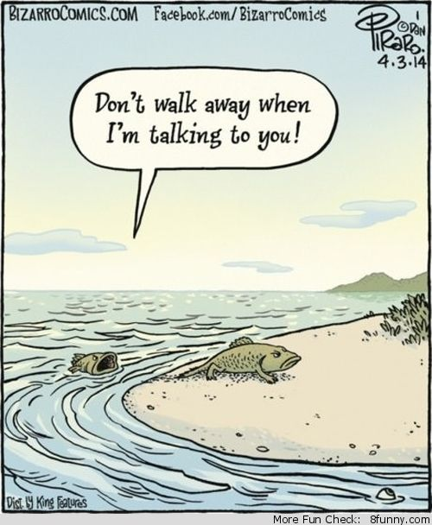
Evidence for Evolution
The Fossil Record
Comparative Anatomy and Embryology
Comparative genomics (molecular evidence)

Slide 48
Question 10. Glossopteris is a genus of flowerless seed ferns, common 250 million years ago, it is now extinct. Many species of Glossopteris have been identified from leaf fossils.
a. Define the term ‘fossil’. (1 mark)
preserved remains/impression/traces of an old/ancient/extinct organism
b. Outline how fossils can provide evidence for evolution. (3 marks)
show past life/extinct organisms 1
show that life has changed over time or that life on earth has a long history 1
show how one type of organism/structure has transitioned to another 1
Notes:
Note the instructional; verb- ‘describe’, 4 marks pick 4 changes

Slide 49
c. It has not been possible to determine the total number of Glossopteris species because the fossil record is incomplete. List four reasons why the fossil record is incomplete. (4 marks)
only hard parts are likely to form fossils or soft parts are unlikely to form fossils
only organisms that avoid decomposition/scavengers/predators form fossils or fossils only form in areas with no oxygen/bacteria
only organisms that are buried in sediment/mineral rich water form fossils or rapid burial
not all fossils have been found yet
some fossils have been destroyed (by volcanic eruptions/human activities/earthquakes)
d. Approximately when did life first evolve on Earth? (1 mark)
3.5 billion years ago (accept any answer between 3 and 4 billion) or Archaean or Palaeozoic
e. Describe the first life forms on Earth. (3 marks)
microbes/single cell
simple cells/prokaryotes
bacteria/bacteria-like/archaea
aquatic/anaerobes/marine

Slide 50
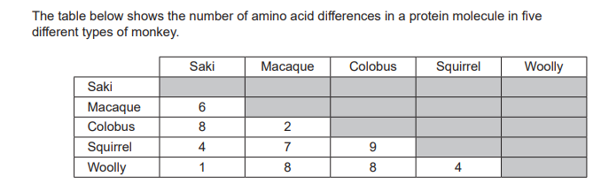
f. Use these data to describe the evolutionary relationships of these monkeys. (4 marks)
saki and woolly are closely related/most closely related 1
colobus and macaque are closely related/next most closely related 1
squirrel, saki and woolly form a related group or colobus and macaque are distantly related to others or form a distinctive group 1
any accurate quote of data (must give names of monkeys and number of amino acid substitutions)
Notes:
Instructional verb- ‘explain’

Slide 51
g. Explain how differences in the amino acid sequence of a protein can provide evidence of evolutionary relationships between organisms. (4 marks)
Either
sequence of amino acids in a protein is determined by a DNA sequence
the more similar the amino acids, the more similar the DNA sequence
organisms with similar DNA/amino acid sequences are closely related
because they diverged more recently
less time to accumulate mutations/differences
or
sequence of amino acids in a protein is determined by a DNA sequence
the more different the amino acids, the more different the DNA sequence
organisms with different DNA/amino acid sequences are not closely related
because they diverge a long time ago
more time to accumulate mutations/differences

Slide 52
Natural Selection …“the selection of those alleles (genes) in a population that give an organism greater survival advantage.”
Q11. The islands in the Caribbean Sea are home to more than 150 species of lizard, all belonging to the genus Anolis. It has been hypothesised that all these species are the descendants of two original populations of lizard. Each species has unique features that enable it to live in its habitat. The lizards are found in mountain ranges, woodlands, and rainforests. Many Caribbean islands have only one species of Anolis lizard. [SACE Biology 2014]

Slide 53
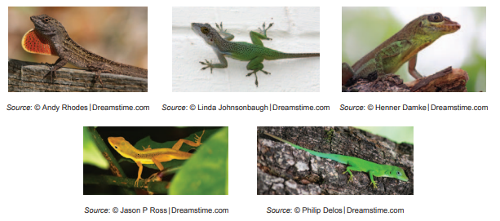
Describe:
• two important events that occur during gamete production, increasing the chances of survival and reproduction of Anolis lizards
• how natural selection resulted in the evolution of more than 150 species of Anolis lizards in the Caribbean islands.

Slide 54
COMMON ANCESTOR (1) WIDE SPREAD DISTRIBUTION
COMPETITION (1) for RESOURCES Environmental pressure
POPULATIONS BECOME SEPARATED/ISOLATED or OCCUPY A SPECIFIC NICHE (1) Isolation (may be physical, or behavioural)
SURVIVAL OF THE FITTEST: MOST FIT INDIVIDUALS SURVIVE TO PASS ON GENES TO NEXT GENERATION (1)
ADAPTION TO ENVIRONMENT (1)
LEADING TO SPECIATION – UNABLE TO INTERBREED (1)
(Adaptive Radiation)
Rise in frequency of alleles that favour survival

Slide 55
Allele Frequencies in a gene pool
Explain how an advantageous allele can arise and then spread through a population. (10 marks) WACE 2016 Extended Response
  2 parts to this question- be sure to answer BOTH
  How advantageous alleles arise: mutation, OR gene flow
  Answer using the principles of natural selection
Question 13: “Discuss how ‘genetic drift’ and ‘gene flow’ change allele frequencies in the gene pool of a population.” (10 marks) WACE 2018 Extended Response

Slide 56
Allele Frequencies in a gene pool continued
Question 13. answer: Genetic drift 5 marks
Most noticeable when only a small number of individuals reproduce.
Only a small subset of alleles are passed on
So allele frequencies change
These changes are random
Off spring are a result of a small breeding population and are not representative of population as a whole.
Occurs because of small population size- due to endangered species, low number of breeding individuals, captive population..
Or bottlenecks/temporary reductions in population size
Or founder effect/population is started by small number of individuals

Slide 57
Allele Frequencies in a gene pool continued
Question 13. answer: Gene Flow 5 marks
Happens when individuals migrate from one population to another, then breed adding their alleles to the gene pool
Allele frequencies between the two populations may be different
Migrants may have different alleles/allele frequencies to the destination population
Migrants will change the allele frequencies in the destination population
The allele frequencies between the source and destination population may become more alike
Immigrants can introduce new alleles, emigrants can remove alleles

Slide 58
